Slide 1




Understanding Hospital Demand in New South Wales Australia
IBM Applied Data Science Capstone Project

Slide 2

Providing better healthcare!
In order to provide better health care service it is imperative for every government to understand and forecast the demand of healthcare services as the population grows.
The issue is that it requires large amount of budget to maintain the existing healthcare infrastructure and to develop new ones.
Therefore, governments generally struggle to balance the available resources where the actual need is.

Slide 3
Data acquisition and cleaning
Data on hospitals in NSW is obtained from Foursquare database.
Local Health Districts Population for 2021 from NSW Heath website.
Local Health Districts boundaries from NSW Health website.
Data was merged and cleaned and converted into Data Frames to obtain required information from the primary data.

Slide 4
Methodology
First the understanding of the current scenario will be done. This will include determining the location of the hospitals in NSW and the estimate of the current population in each local health district.
Then analysis of capacity of each hospital will be done.
This data will be compared with the international KPI to determine if the current capacity is fulfilling the demand.
Finally the local health districts will be identified which require additional hospitals to cater the population.

Slide 5
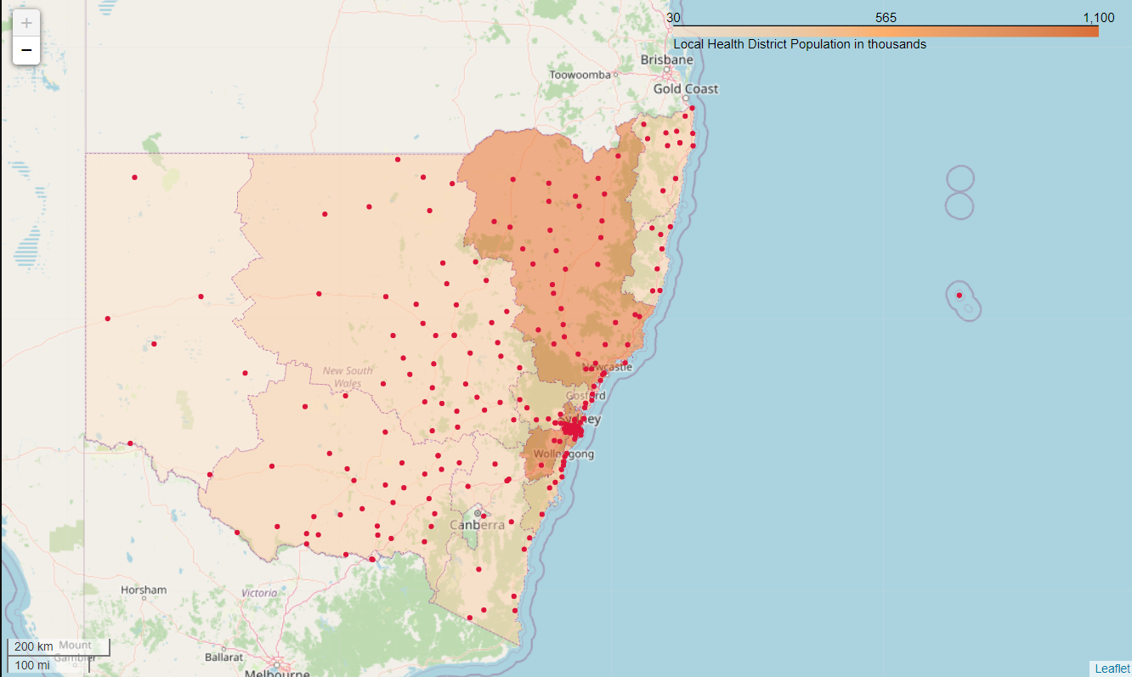
Distribution of public health services
The figure shows the location of public hospitals in the state of New South Wales.
The boundaries are the Local Health Districts with shading representing the current population in the district.

Slide 6
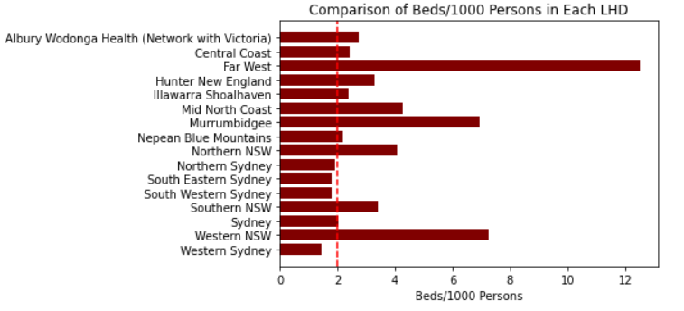
Current situation of public health services availability
The graph shows the comparison between different local health districts with respect the beds per 1000 person. The red line indicates average of 2 beds per 1000 persons required.
It shows that there are few districts which fall below the standard.

Slide 7
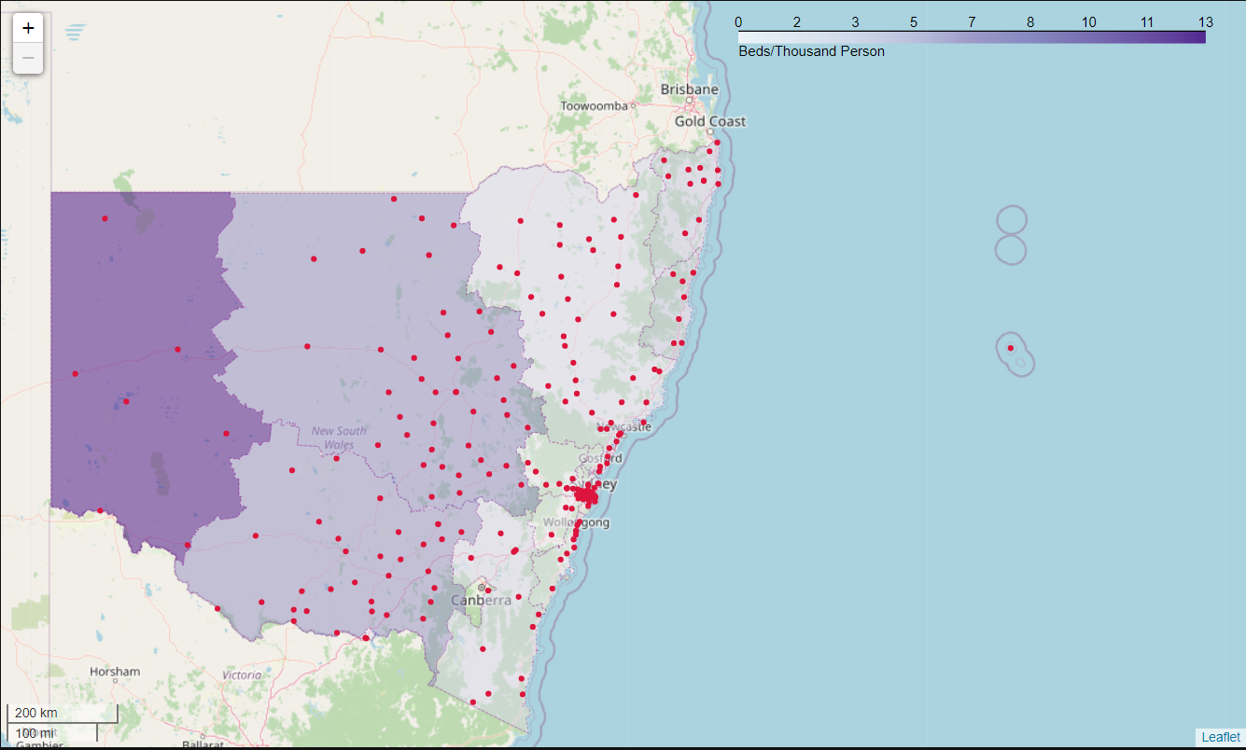
Identification of areas of demand
The local health districts having ratio lower than required are Northern Sydney , South Eastern Sydney , South Western Sydney and Western Sydney .
Therefore, these districts should be provided more hospitals to cover the shortage. The map below shows the areas of shortage.

